Slide 1

Introduction to the processing mode files "PModes" eDelivery
DIGIT
Directorate-General for Informatics
DG CONNECT
Directorate-General for Communications Networks, Content and Technology
November 2015

Slide 2
Table of content
1 | Introduction
2 | Configurable parameters
3 | Example of custom configuration
4 | Fixed elements
5 | References

Slide 3
Introduction
1

Slide 4
Introduction to eDelivery
eDelivery prescribes technical specifications that can be used in any Policy Domain of the EU to enable secure and reliable exchange of documents and data both across borders and sectors.
There can be several eDelivery Nodes deployed per Member State. Each node is deployed for a specific Pan-European Project within a given policy domain: eJustice, eProcurement, etc. Typically, the nodes of eDelivery are uni-domain and uni-project.
The deployment model must be defined upfront by the Pan-European project.
Backend
Network
Backend
eDelivery
node
SEND
RECEIVE
eDelivery
node
AS4
Role: Sending
Role: Receiving
Notes:
The EC is responsible for the flow highlighted inside the box
Users come with a client and use the their gateway's façade to submit /receive messages

Slide 5
AS4 Protocol
AS4 is a Conformance Profile of the OASIS ebMS 3.0 specification, and represents an open standard for the secure and payload-agnostic exchange of Business-to-business documents using Web services. Secure document exchange is governed by aspects of WS-Security, including XML Encryption and XML Digital Signatures.
AS4 became a standard in 2013.The majority of the AS4 profiling points constraining the ebMS 3.0 specification are based upon the functional requirements of the AS2 specification. AS4 provides an entry-level on-ramp for Web services B2B by simplifying the complexities of Web services.
A standard for reliable and secure message exchange using web services
Payload agnostic (Not sensitive to the type of attachement)
Implementation guideline within ebMS 3.0
Notes:
AS4 is a Conformance Profile of the OASIS ebMS 3.0 specification, and represents an open standard for the secure and payload-agnostic exchange of Business-to-business documents using Web services. Secure document exchange is governed by aspects of WS-Security, including XML Encryption and XML Digital Signatures. Payload agnosticism refers to the document type (e.g. purchase order, invoice, etc.) not being tied to any defined SOAP action or operation.
AS4 became a standard in 2013.The majority of the AS4 profiling points constraining the ebMS 3.0 specification are based upon the functional requirements of the AS2 specification. By scaling back ebMS 3.0 by using AS2 as a blueprint, AS4 provides an entry-level on-ramp for Web services B2B by simplifying the complexities of Web services.

Slide 6
End-user perspective
PARTICIPANT 1
PARTICIPANT 2
Business application
Business application
What you see
Gateway A
Validate & Archive
Behind the scenes
Validate & Archive
Gateway B
Translate to standardized format
Translate to in-house format
Encrypt and sign
Decrypt and verify signature
Lookup recipient address details
Verify sender
Send
Send message
Receive
Acknowledge receipt
Notes:
The outlined space represents the gateway.
The sender's gateway processes the validation, compression, encryption and signing the user message before sending it to the recipient's gateway.
The recipient's gateway receive the encrypted message, verify the sender, decrypt, and uncompression.
Those data are centralized in the PModes configuration files.

Slide 7
PModes
A PMode (or Processing Mode) is a collection of parameters that determine how User messages are exchanged between a pair of gateways with respect to quality of service, transmission mode, and error handling.
Processing modes (PModes) maps the recipient gateway from the partyId.

Slide 8
Configurable parameters
2
How to configure a PMode configuration file?

Slide 9
Using PMode to resolve recipient's address
Gateway A
3
Gets the endpoint of the Gateway associated to instanceBId1
4
Sends the message to the recipient's gateway
Gateway B
2
PMode metadata
DB
Looks for the endpoint address for instanceBId1 in DB
Receiver
Sender
SOAP Req
From:
instanceAId1
To:
instanceBId1
1
5
Delivering MSG
Sending MSG
BackEnd partyAId1
BackEnd partyBId1

Slide 10
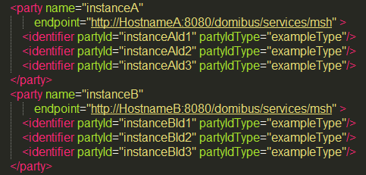
Parties container
PMode[1].businessProcesses.parties.party: This parameter Contains the name of the partner gateways and the address (endpoint URL) of the Receiver MSH to which User Messages under this PMode are to be sent.
PMode[1].businessProcesses.parties.party.Identifier: This Parameter contains the name of the clients' backend associated to the parent gateway.
Hostname of the Gateway
Endpoint URL of the recipient Gateway
Notes:
This section of the PMode has to be modified in case we need to add new gateways or the party's associated to it.
Parties section of the gateways will contain all the gateways to/from it can send/receive the messages.
The <identifier> represents the clients' backend associated to the parent gateway
Party = Gateway
Example: For the instanceA, we have considered 3 associated backends.
The tag partyIdType calls a definition type for the identifier elements

Slide 11
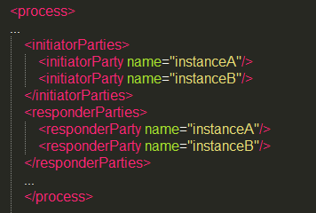
Process container
PMode[1].businessProcesses.process.initiatorParties: This container regroups the names of the parties who has the right to initiate a message exchange.
PMode[1].businessProcesses.process.responderParties: This container regroups the names of the parties who has the right to respond to a request.
Notes:
The container defines who has the right to initiate a transaction, and to respond.
When adding a gateway, we need to assign the right for this gateway to initiate, to respond, or both in that container.
*********************************************************
Both can initiate

Slide 12
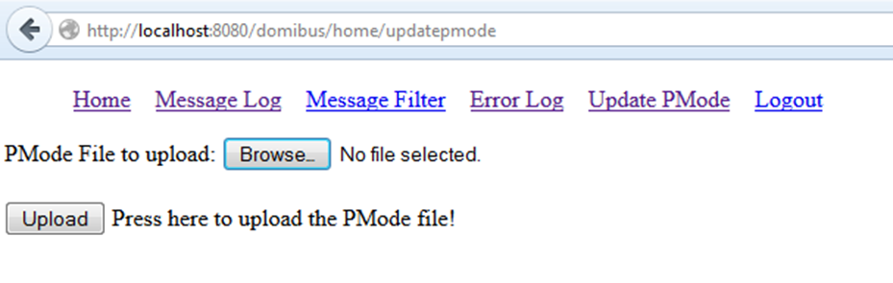
Uploading the PMode to the gateway's DB (Admin)
Login to server's administration dashboard
Browse to the configured PMode file and hit upload.
This will upload the PMode data into the gateway's DB.

Slide 13
Example of customizing
3
How to add a gateway "C"?

Slide 14
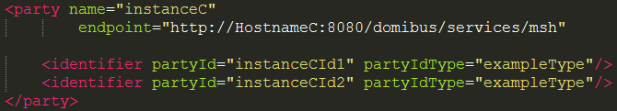
Editing the "parties" container for adding a new Gateway C
Party Name is the name of the new gateway C.
Endpoint is the endpoint URL of the recipient gateway C.
PartyId are the backend offices associated to the gateway C
After adding this section to the gateway the updated PMode has to be uploaded to the gateway.

Slide 15
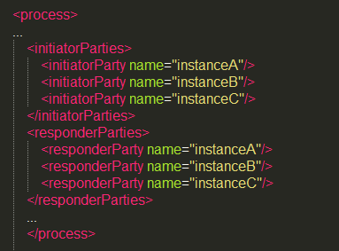
Editing the "process" container

Slide 16
Fixed elements
4
What are the fixed elements in the PModes?

Slide 17
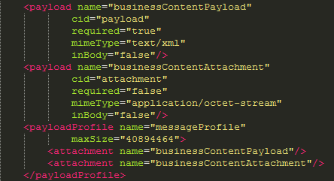
Payload Profile
Notes:
PMode[1]. businessProcesses.PayloadProfile: This parameter allows for specifying some constraint or profile on the payload. It specifies a list of payload parts. A payload part is a data structure that consists of four properties: name (or Content-ID), mime data type (text/xml, application/pdf, etc…), name of XML schema file if the mime data type if text/xml, and a Boolean value indicating whether the part is expected or optional, within the User message. The message payload(s) must match this profile.
The gateway has features to manage the payloads via a concept known as profile. For Message profile the following configurations should never be modified.
There are two type of attachmnets allowed in th eUser message.
Payload – This part of the message is of type text/xml. This is mandatory attachment and it contains the business message.
Attachment – This part of the message is of type application/Octet-stream(Binary). This is optional and it contains the attachment file if any.

Slide 18
AS4 Reliability
PMode[1].businessProcesses.as4.reliability.replyPattern: This parameter indicates whether a reliability acknowledgement is to be sent as a callback, synchronously in the response (back-channel of underlying protocol), or as response of separate acknowledgement pulling. Three values are possible for this parameter, when using WS-Reliability: Response, Callback, Poll.
PMode[1].businessProcesses.as4.receptionAwareness.retry: This parameter defines the number of retries for Gateway to send the user message towards the Partner Gateway.
PMode[1].businessProcesses.as4.receptionAwareness.duplicateDetection: This is a Boolean parameter to set the Gateway for duplicate Message detection. If this property is set to 'TRUE' , Gateway will reject the message in case it received the same message twice.
Notes:
Retry values: 1-6 : If the message doesn't reach the receipient's gateway / sender's gateway doesn't receive the AS4 acknowledgement receipt, the sender's gateway will try to send the message again six times.
CONSTANT: Maps to a strategy; will have always the CONSTANT value.
Duplicatedetection true: If this property is set to 'TRUE' , Gateway will reject the message in case it received the same message twice.
nonRepudiation true: (sending and receiving without signature?)
ReplayPattern values?
Response why?
Callback when?
Poll when?

Slide 19
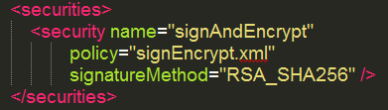
Security (Between the Gateways)
PMode[1].businessProcesses.securities.security.name :Defines the name of the Policy to be used for security.
PMode[1].businessProcesses.securities.security.policy: This parameter defined the name of the XML file which contains the other security parameters
PMode[1].businessProcesses.securities.security.signatureMethod: The value of this parameter defines the algorithm to be used for the digital signatures.
Notes:
Do we have any security implementation between backend and gateway?
What are the possible values for Policy and signature method. How these relate to WS-Security standard.

Slide 20
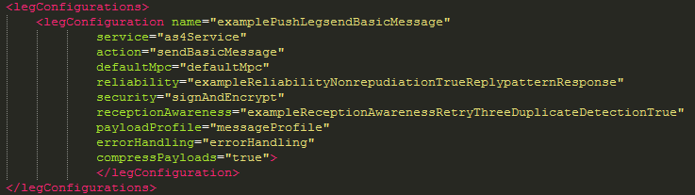
PMode Legs
A PMode governs the transmission of all the messages involved in an ebMS MEP. Because messages in the same MEP may be subject to different requirements - e.g. the reliability, security and error reporting of a response may not be same as for a request – the PMode will be divided in “legs”. Each user message label in an MEP is associated with a PMode leg.
Notes:
To be removed?
The One-Way MEP which governs the exchange of a single User Message Unit unrelated to other User Messages
The Two-Way MEP which governs the exchange of two User Message Units in opposite directions, the first one to occur is labeled "request", the other one "reply".
Push: maps an MEP User message to the 1st leg of an underlying 2-way transport protocol, or of a 1-way protocol. This binding is identified by the URI Pull: maps an MEP User message to the second leg of an underlying two-way transport protocol, as a result of an ebMS Pull Signal sent over the first leg. This binding is identified by the URI

Slide 21
References
5
What are the fixed elements in the PModes?

Slide 22
Official documentation
OASIS ebXML Messaging Services Version 3.0: Part 1, Core Features.
October 1st 2007 OASIS standard.
http://http://docs.oasis-open.org/ebxml-msg/ebms/v3.0/core/os/ebms_core-3.0-spec-os.html
AS4 Profile of ebMS 3.0 Version 1.0.
January 23rd 2013 OASIS standard.
http://docs.oasis-open.org/ebxml-msg/ebms/v3.0/profiles/AS4-profile/v1.0/os/AS4-profile-v1.0-os.html
e-SENS ebMS3 Profile.
2014. e-SENS Project.
http://wiki.ds.unipi.gr/display/ESENS/ABB+-+Message+Exchange+Protocol

Slide 23

CEF-EDELIVERY-SUPPORT@ec.europa.eu
+32 229-90909

